Slide 1
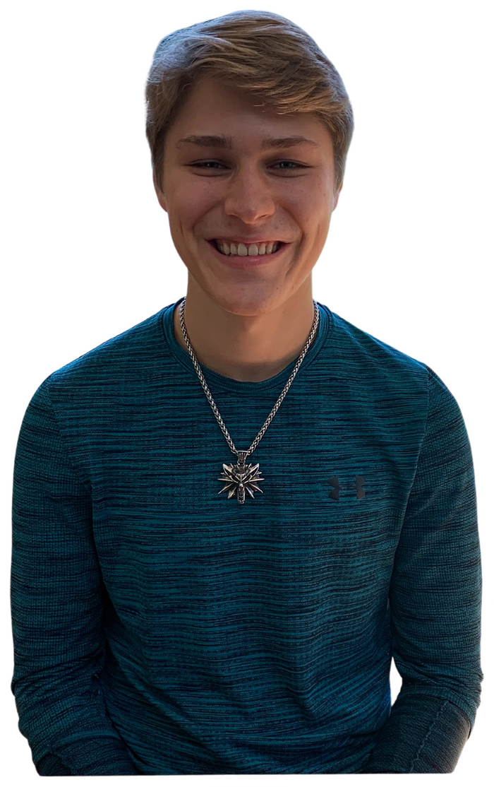
Welcome to the Class!

Slide 2
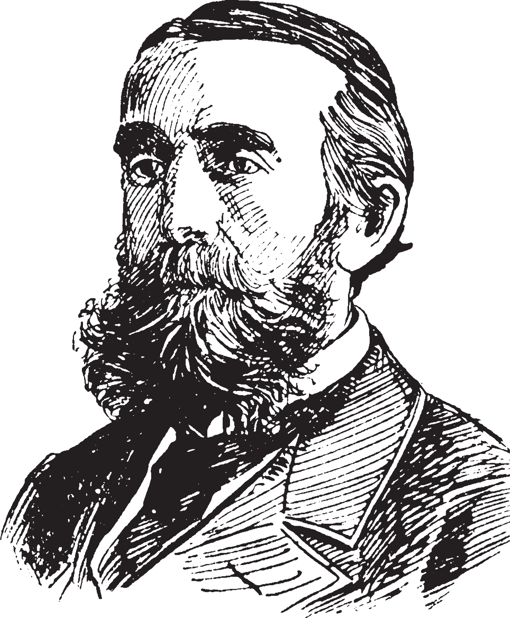
backround on me:
1. studying at cornell university
2. favorite hobby is inspiring love for learning through youtube/blogging

Slide 3
feel free to ask questions
Not urgent wait until end
raise your hand before asking
I want this to be very interactive

Slide 4
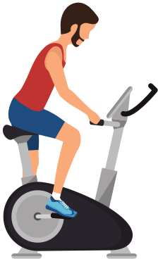
What you will learn:
1. elon musk and the power of habit
2. four step process of habituation
3. techniques for habit change

Slide 5
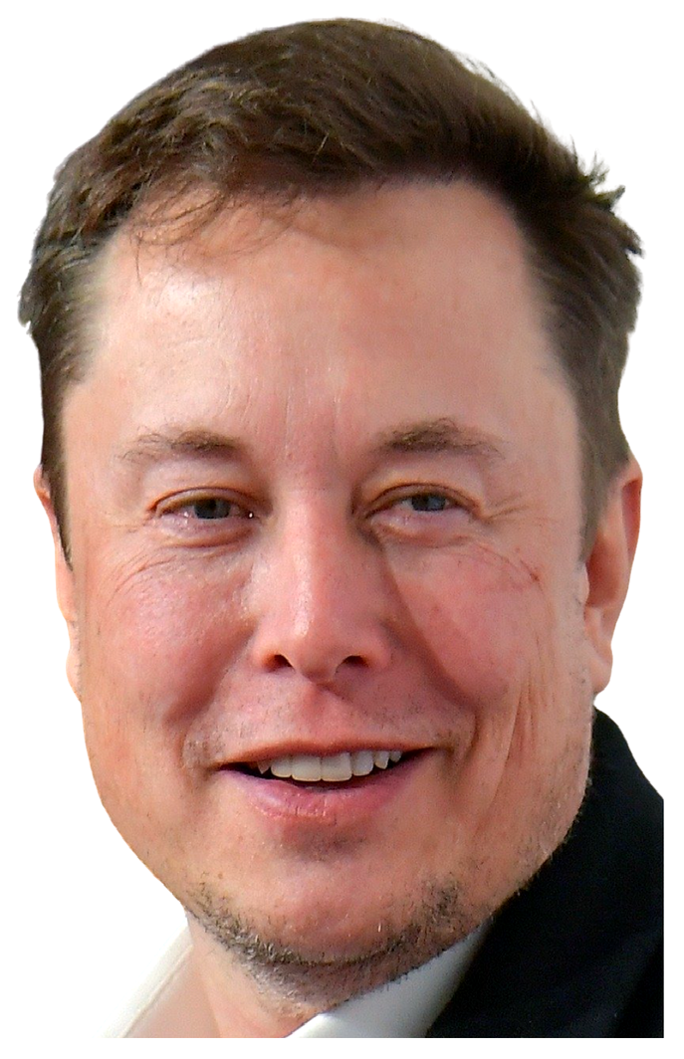
What differentiates you from elon musk?

Slide 6
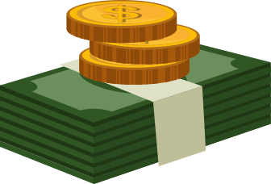
elon's differences and similarities:
differences:
similarity:
genetics
2. unfair advantages
he is beholden to the same 24 hours that we are

Slide 7
the power of habit
"1% worse every day for one year: .99^356 = 00.03
"1% better every day for one year: 1.01^356 = 37.78

Slide 8
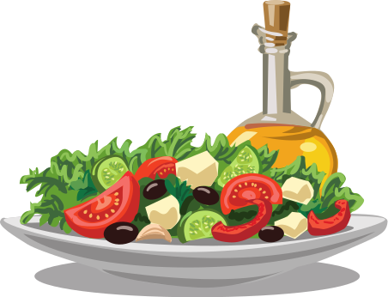
elon's habits differentiate him
works 16 hour days, weekends
claims to read 500 pages/day
is not scared of failure
time blocks day 5 min chunks
eats very healthy
proactivity/diligence
*not saying you should strive for his habits. Just saying what differentiates us are his habits*

Slide 9
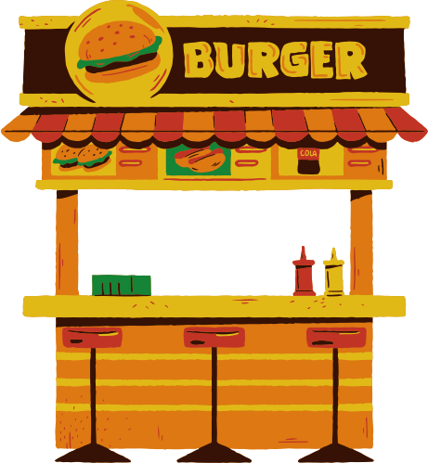
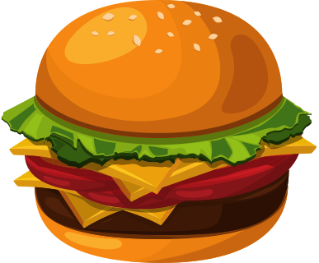
the four step process of habituation:
cue:
2. craving:
3. response
4. reward

Slide 10
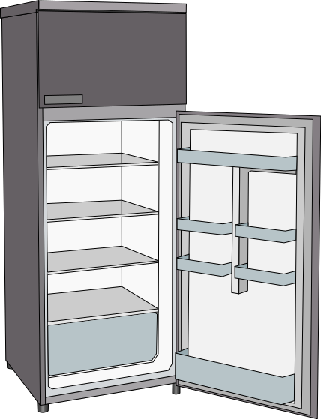
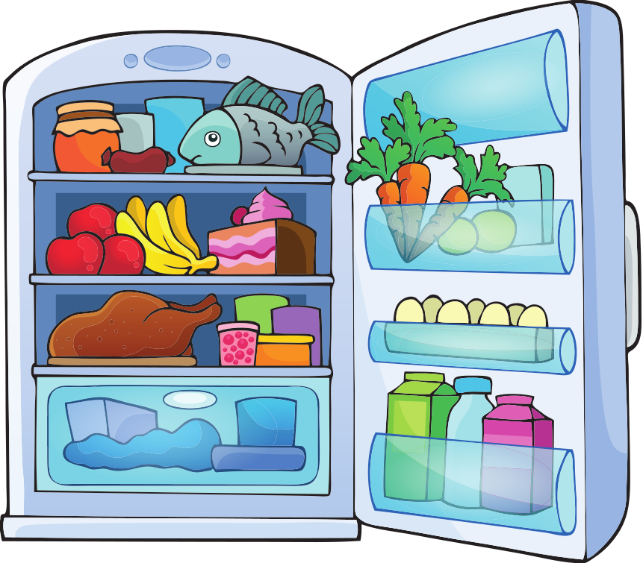
the four step process of habituation:
cue:
2. craving:
3. response
4. reward

Slide 11
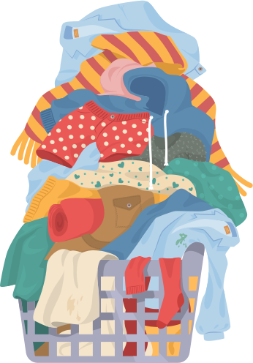
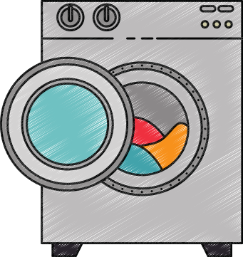
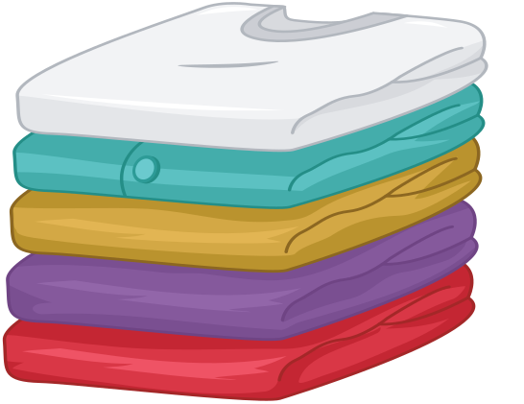
what are the relevant steps?

Slide 12
what are the relevant steps?
hopefully: :)

Slide 13
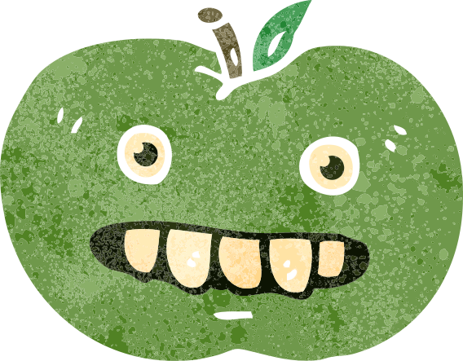
how to break a bad habit:
make it invisible:
2. make it unnatractive:
3. make it hard
4. make it unsatisfying

Slide 14
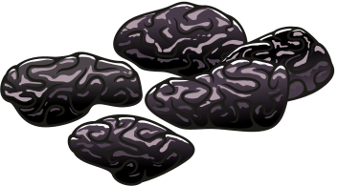
example:
make it invisible:
2. make it unnatractive:
3. make it hard
4. make it unsatisfying
raisins

Slide 15
how to build a good habit:
make it obvious:
2. make it attractive:
3. make it easy
4. make it satisfying

Slide 16
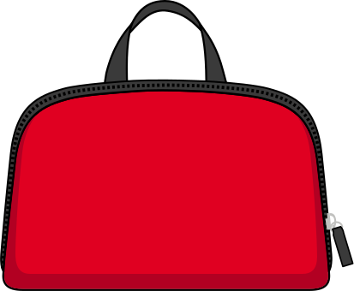
example:
make it obvious:
2. make it attractive:
understand flossing vastly increases tooth health
bathroom bag is on sink
3. make it easy
4. make it satisfying
bathroom bag has floss
track successful occurences

Slide 17
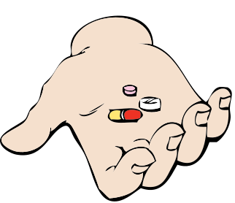
build identity along with habits
A woman is trying to stop smoking when offered a cigarette
scenario 1:
scenario 2:
"Sorry, I am trying to quit."
"Sorry, i don't smoke."
whats the difference?

Slide 18
techniques for habit change:
1. implementation intention
2. temptation bundling
3. accountability buddy
4. habit stacking

Slide 19
implementation intention:
"I will [behavior] at [time] in [location]"
schedule it in your calendar!

Slide 20
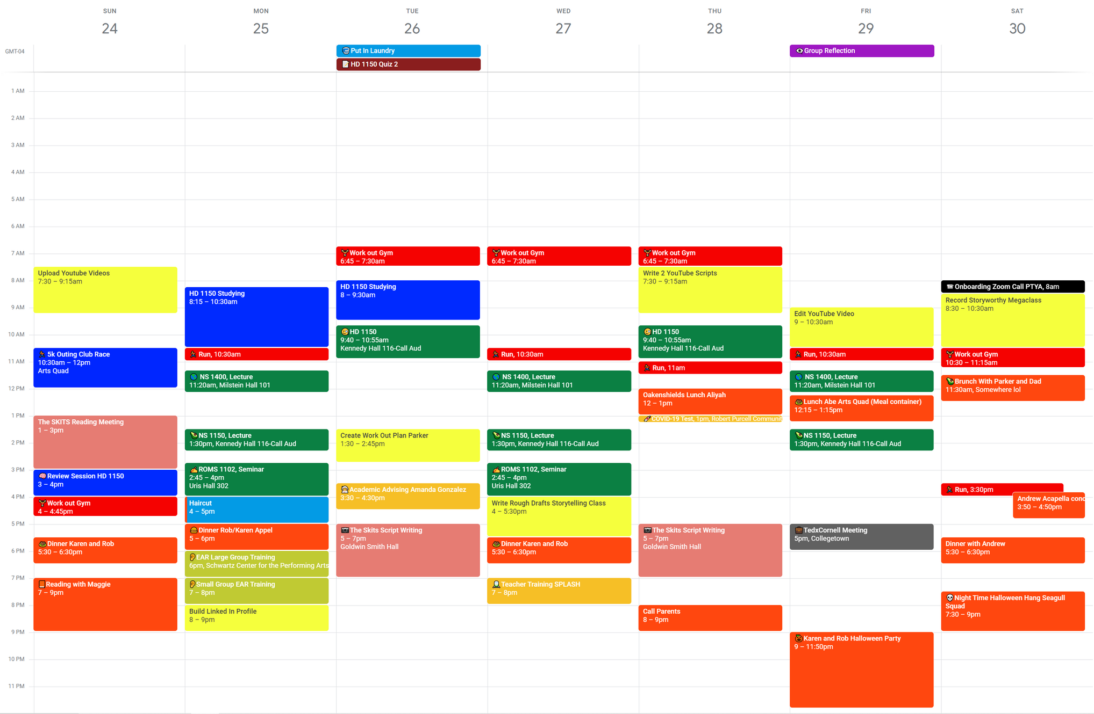

Slide 21
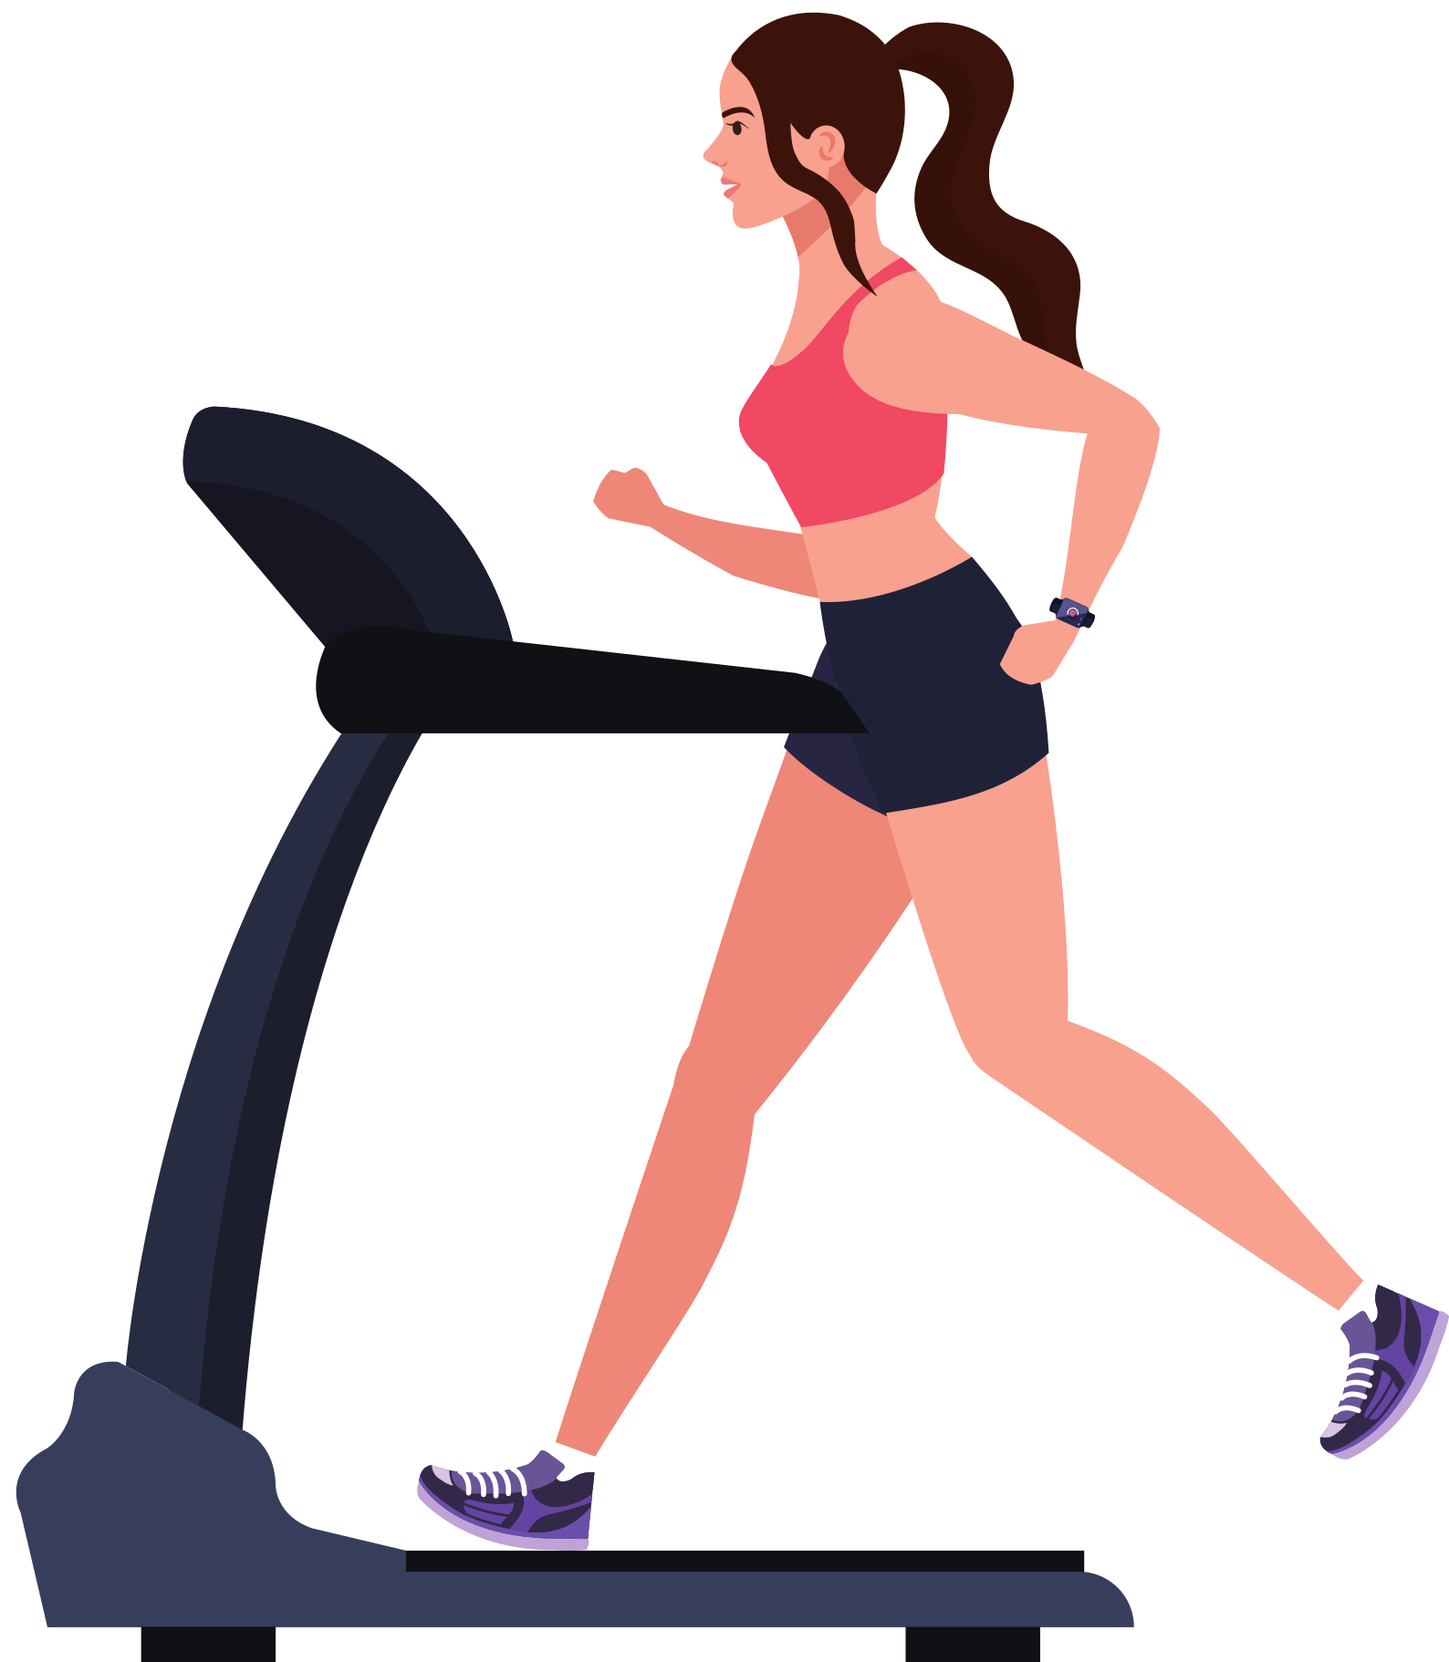
temptation bundling
pair an action you want to do with one you need to do
don't give yourself the reward after the activity!!!

Slide 22
questions?
don't be shy!

Slide 23
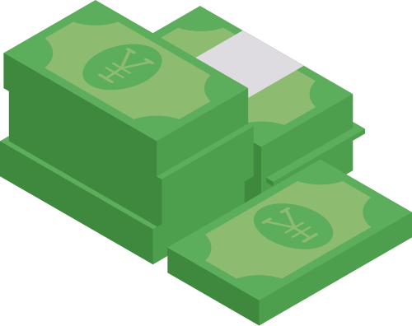
accountability buddy
find someone or something that will keep you accountable
ex: giving away money to someone if you fail
ex: going to the gym with someone
someone: makes you feel bad to miss a day
something: makes missing the habit unsatisfying

Slide 24
habit stacking
"After [CURRENT HABIT], I will [NEW/old HABIT]."
wake up
make bed
meditate
journal
workout
creates flow and allows for unconsious thought

Slide 25
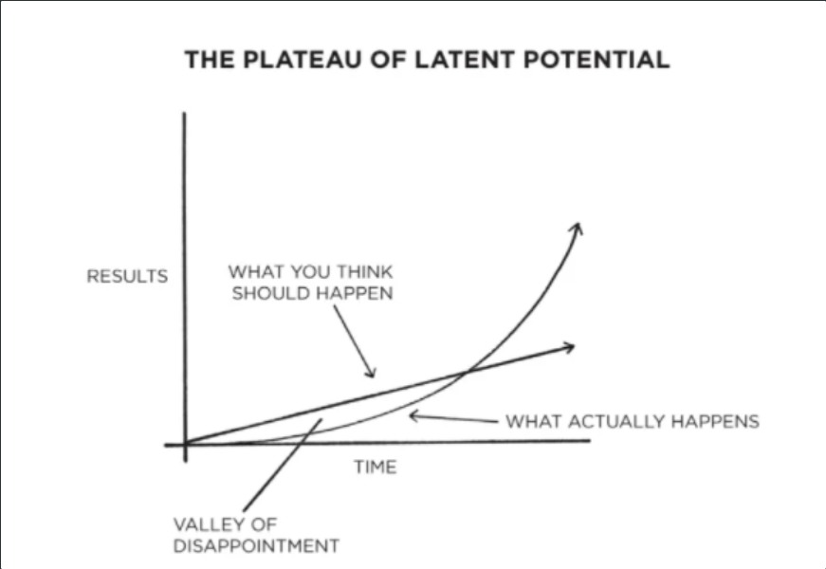
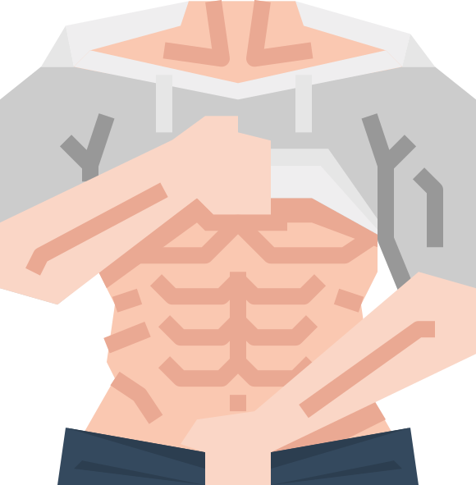
bonus: Plateu of latent potential:
growing on youtube takes time
getting abs takes a long time
"Journey before destination." - Brandon sanderson

Slide 26
questions?
don't be shy!

Slide 27
figure out what traits your ideal self has. Build the habits that make those traits up.
patient
humble
courageous
selfless
proactive
responsible
sophisticated
knowledgeable

Slide 28
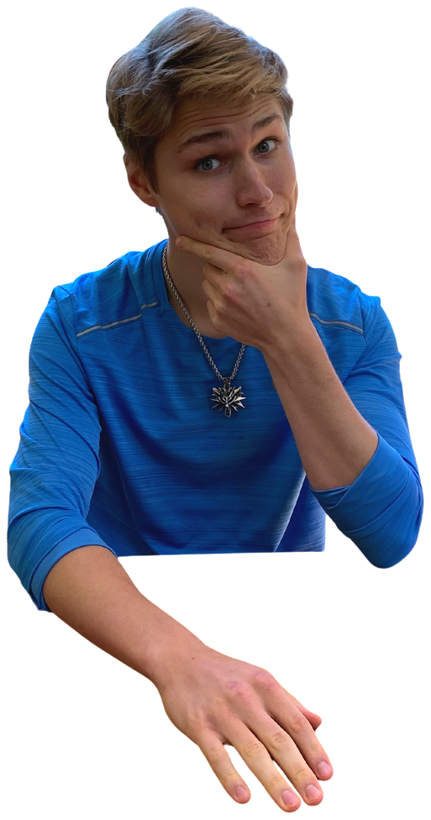
congratulations!
aidan helfant
aidanlifeadvice.com
habit-changing basics

Slide 29
questions?
don't be shy!

